Slide 1
Why Your APPs Know What You Want to Buy?

Slide 2
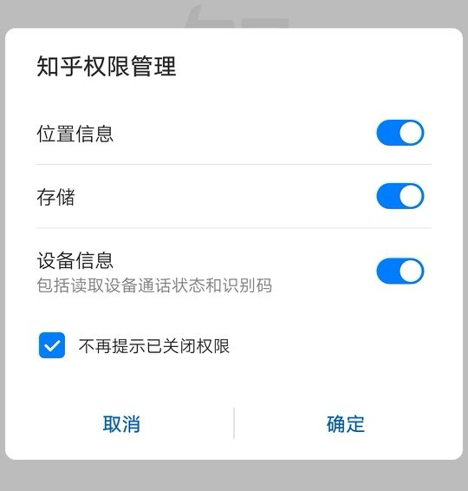

Slide 3


Slide 4


Slide 5
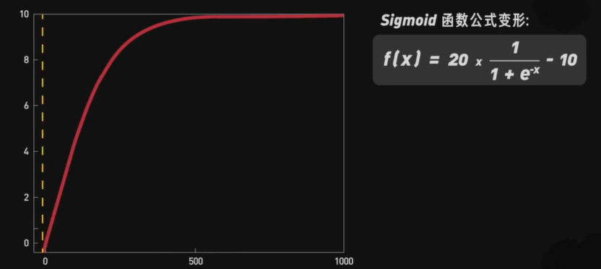
兴趣权重（interest weight）= 行为权重 × 访问时长 × 衰减因子
（behavior weight）
X = the sum of interest weight
So we get an interest label value ranging from 0 to 10
(兴趣标签值)

Slide 6
